Slide 1

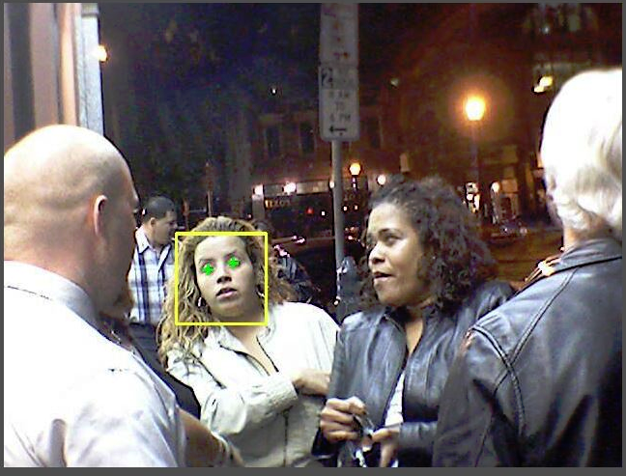


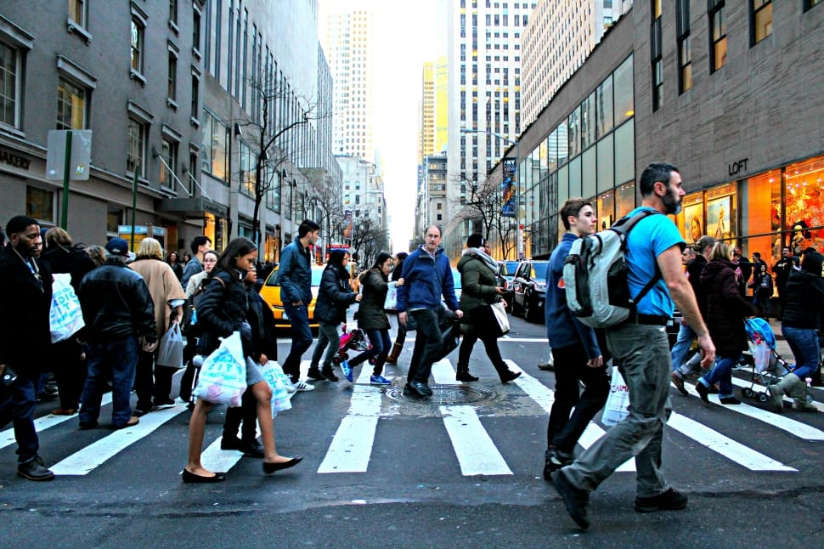
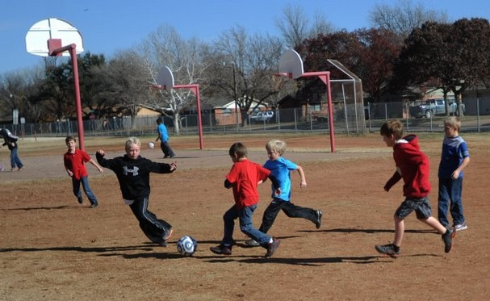

2025 Product Offerings
Eclipse Identity Recognition Corporation
Stephen D. Miller, CEO
Eclipse Identity Recognition Corporation © 2025
1
Confidential & Proprietary

Slide 2
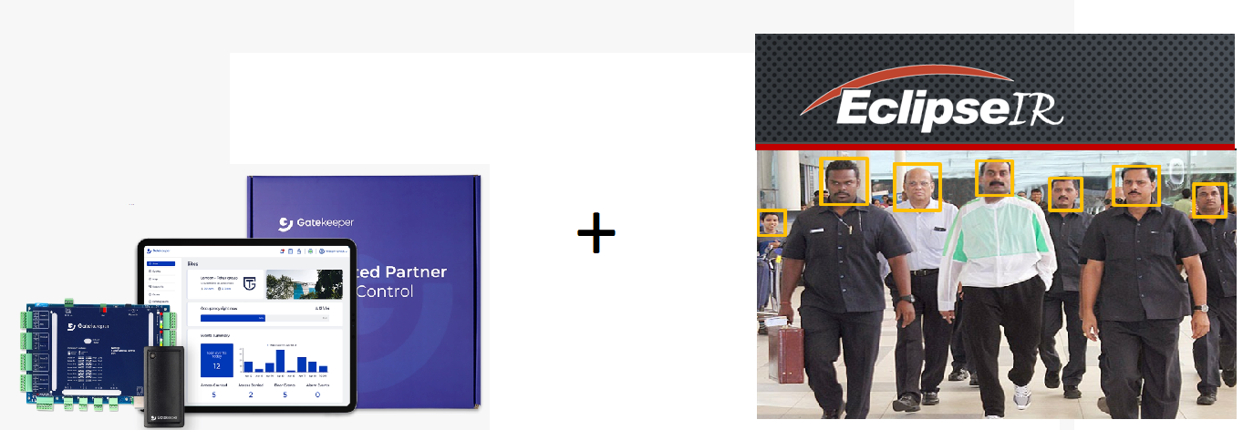
Intelligent Access Control Management
Facial Recognition and Physical Access Management
Our core technology detects faces from video streams
and compares to databases and manages door controllers
Eclipse Identity Recognition Corporation © 2025
2
Confidential & Proprietary

Slide 3

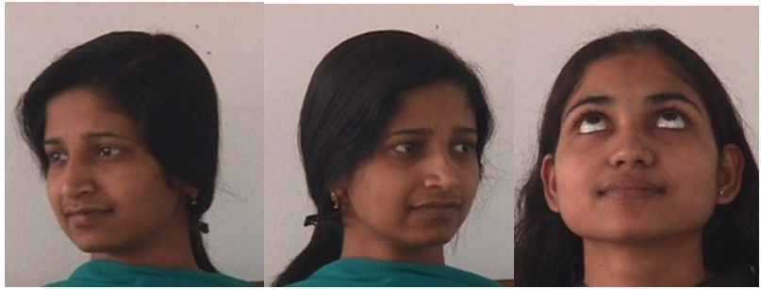

Our Technology
Facial Recognition in the World of Security and Law Enforcement
Real “imperfect” world
Difficult lighting, shadows, movement, skin tone….
Difficult face angles
Multiple faces in a crowd
Eclipse Identity Recognition Corporation © 2025
3
Confidential & Proprietary

Slide 4




Facial Recognition Product Applications
Advanced facial recognition products with market focus
MatchPoint LITE
Live video monitoring
Small Business security
Turn-key single-channel
Rapid deployment
VMS capabilities
Static configurable
MatchPoint 6
Live video monitoring
Corporate and Commercial Security
Multi-channel monitoring
Increased database capacity
Extend VMS capabilities
Static/dynamic configurable
MatchPoint Commander
Live video monitoring
Law Enforcement & Commercial Security
Multi-channel monitoring
Enhanced communications and notifications
Large database size
Static/dynamic configurable
SearchPoint
Investigative Analysis
Corporate and Government
Stored and recorded video
Image Enhancement
Auto Analysis of stored video.
Eclipse Identity Recognition Corporation © 2025
4
Confidential & Proprietary

Slide 5
Facial Recognition Product Offering - 2025
Access Control
Cutting Edge Solutions for Access Control .
MatchPoint Series
Live video Surveillance and Monitoring
SearchPoint
Investigative Analysis of Stored and Provided Video
Eclipse Identity Recognition Corporation © 2025
5
Confidential & Proprietary

Slide 6
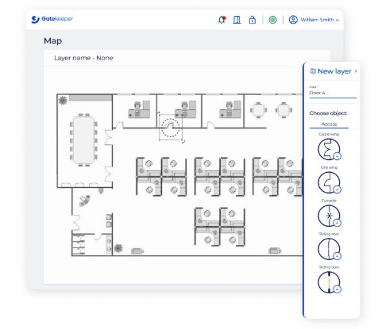
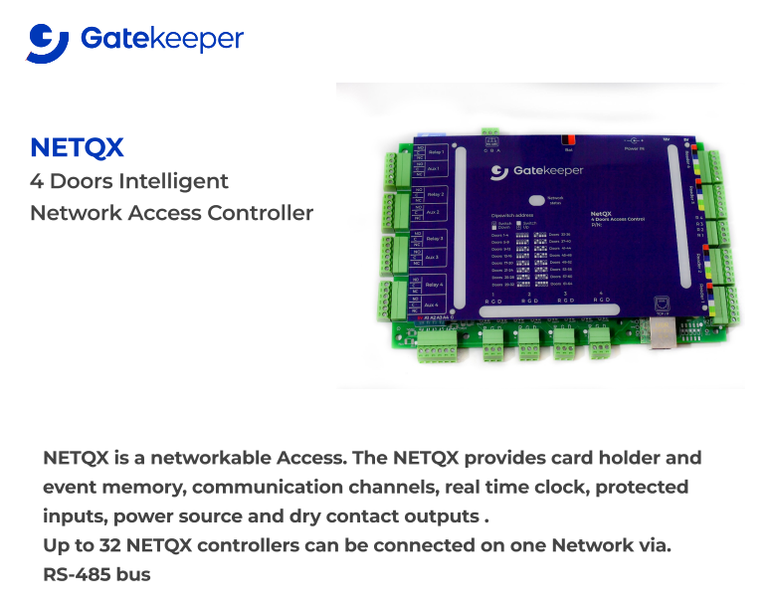
Live Video Surveillance
Physical Access Control
Up to 1024 Doors ENTRY/EXIT Protection on one network
Controller can fully manage 4 doors with readers on Entry and/or Exit
Additional accessories: Door, turnstiles, alarms, Lift control ,locker
Face recognition in a crowd
Eclipse Identity Recognition Corporation © 2025
6
Confidential & Proprietary

Slide 7
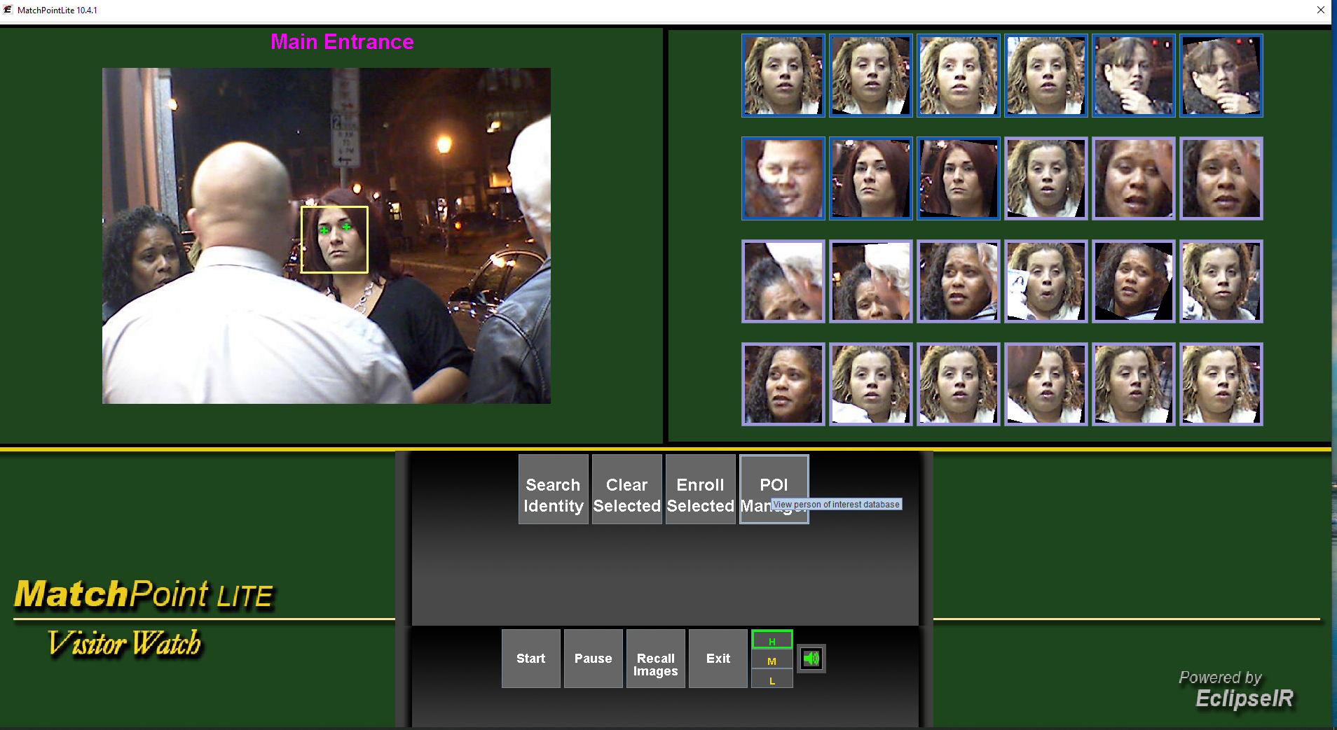
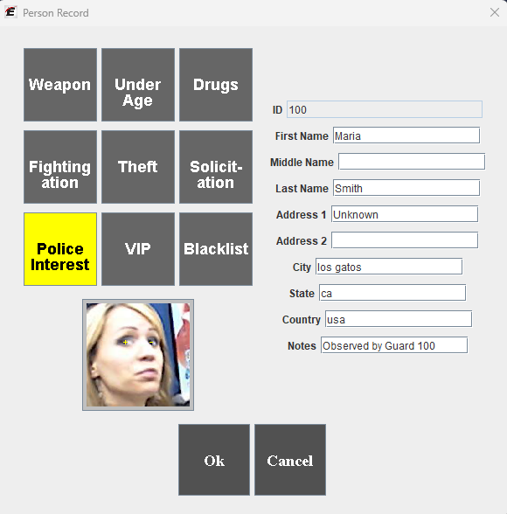

Live Video Surveillance
MatchPoint LITE
Key Features
Live camera viewing
Find/Detect Faces
Compares/Match Faces
Alert on matched faces
Audible alarms
Search Identity
User customizable
Video frame storage capability
250 Person database
Eclipse Identity Recognition Corporation © 2025
7
Confidential & Proprietary

Slide 8
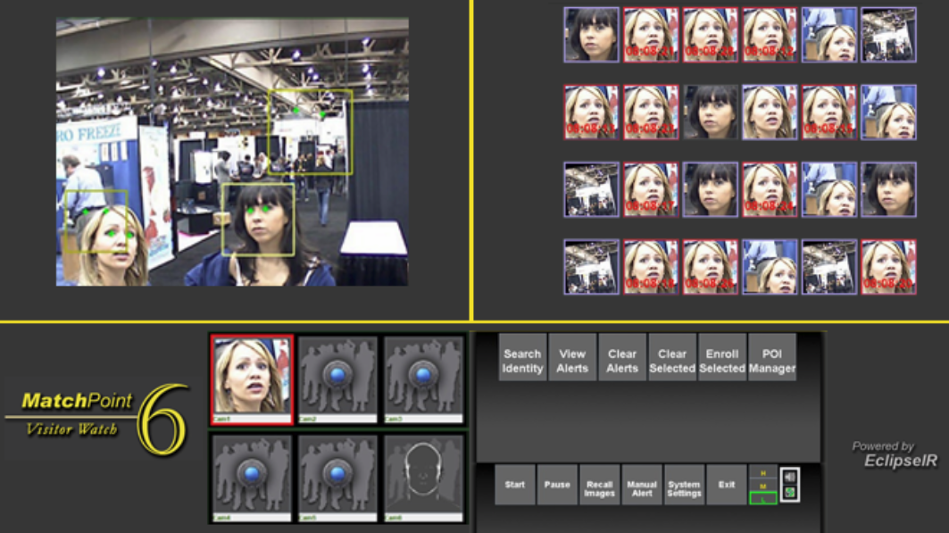
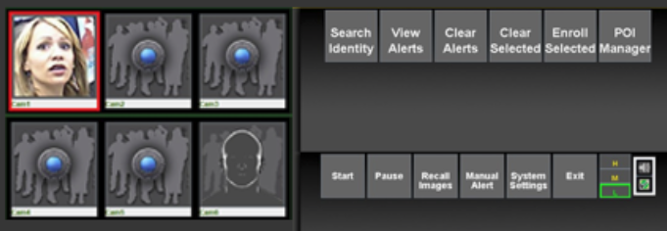
Live Video Surveillance
MatchPoint 6
Key Features:
Six simultaneous cameras
Dedicated enrollment channel
10,000-person database capacity
Alerts from all cameras
Advanced database search
Image Recalls 2 weeks
Expanded management tools
Eclipse Identity Recognition Corporation © 2025
8
Confidential & Proprietary

Slide 9
Live Video Surveillance
MatchPoint Commander
Multiple cameras for high security operations in enterprise deployments.
Advanced communications for rapid security response.
Detected or recognized faces can be transmitted via text messaging and email.
Cities and local government
Hospitals
Corporations
Universities
Government and law enforcement
Eclipse Identity Recognition Corporation © 2025
9
Confidential & Proprietary

Slide 10
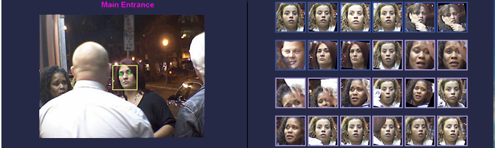


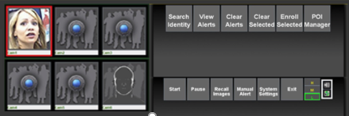

Live Video Surveillance
MatchPoint Commander
Multiple-camera with enhanced communications and alerts
Key Features:
SMS notifications
Email notifications
Six simultaneous cameras
100,000-person database capacity
Advanced notifications and communications of detected and recognized faces.
Eclipse Identity Recognition Corporation © 2025
10
Confidential & Proprietary

Slide 11
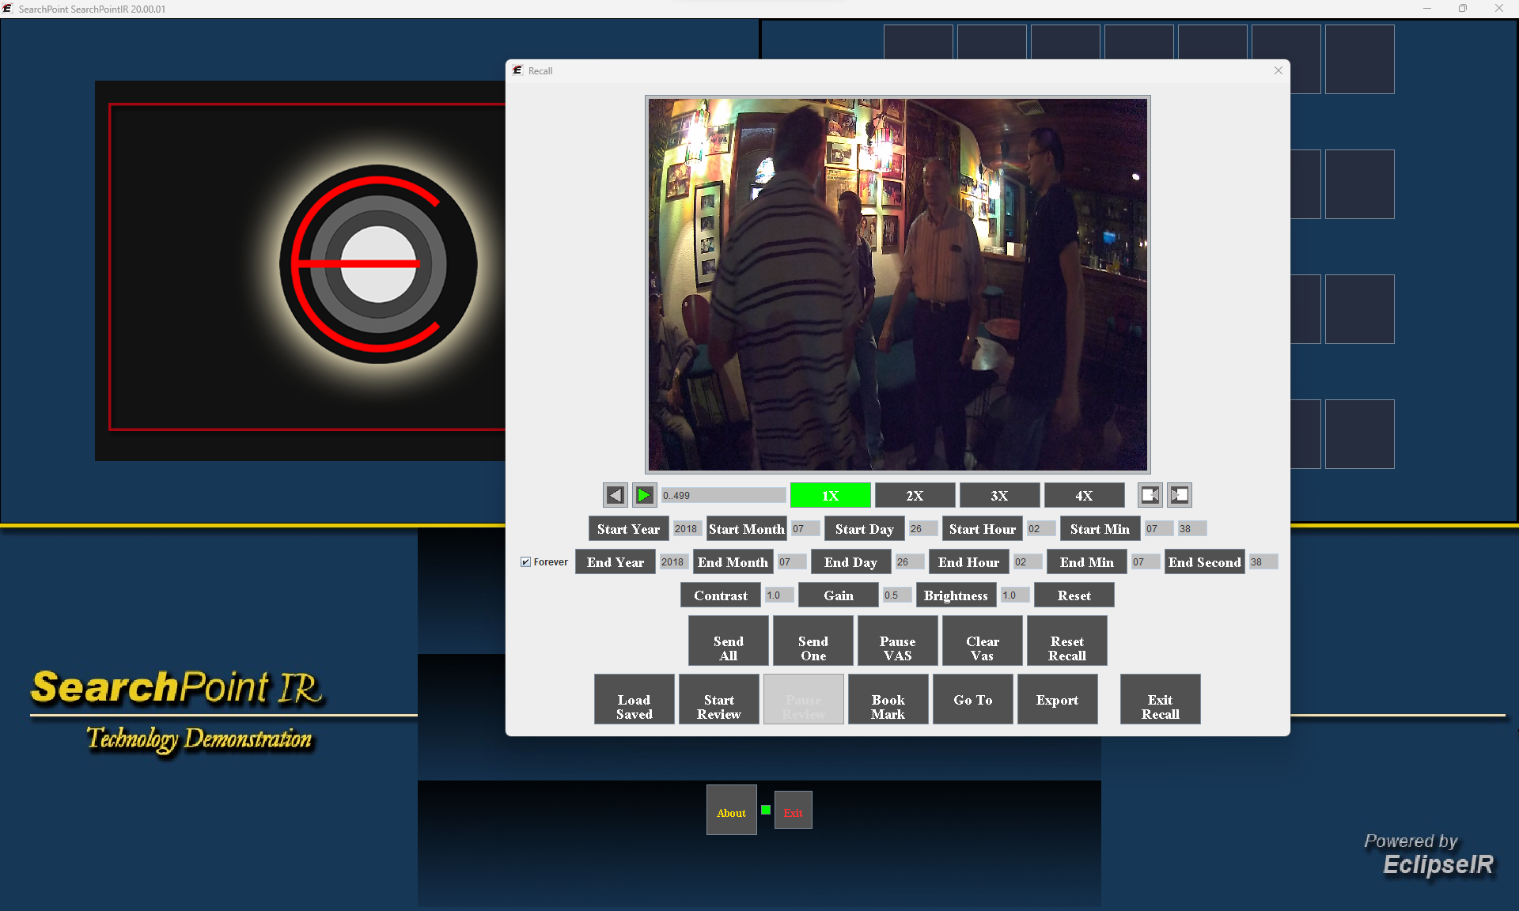
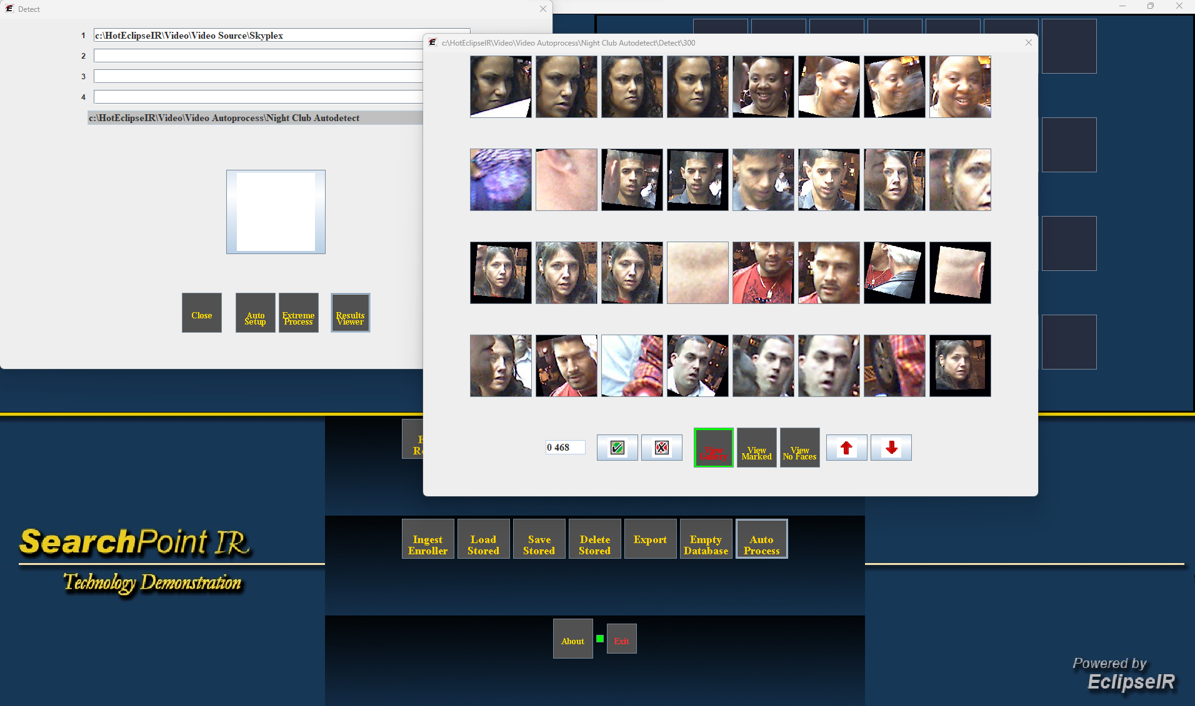
Investigative Analysis of stored video
SearchPoint
Advanced video facial recognition management from stored/recorded video images for investigative analysis.
Key Features:
VMS controls
Video Frame enhancement
Auto processing from stored video for detected and recognized faces.
Facial database creation and management
Database size 100,000
Eclipse Identity Recognition Corporation © 2025
11
Confidential & Proprietary

Slide 12
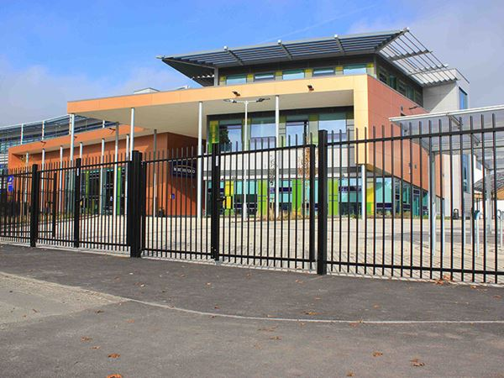
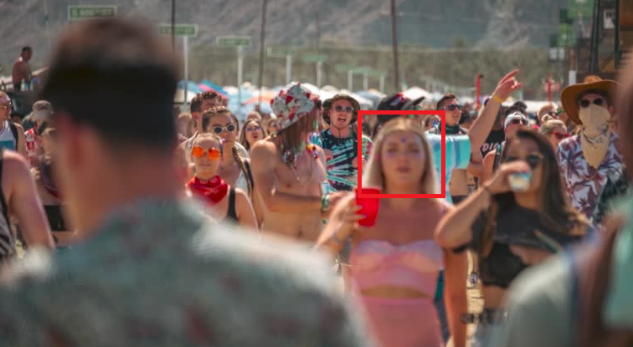
Lock Down integrated with GateKeeper
LockDown
Key Features:
Facial recognition in the crowd
Advanced warning of person of interest
Operator control of door locking
Automatic door locking
Optional in all EclipseIR products
Eclipse Identity Recognition Corporation © 2025
12
Confidential & Proprietary

Slide 13
Product Applications
Advanced facial recognition products with market focus
Small Business
Security
MatchPoint LITE
Turn-key single-channel
Rapid deployment
Images Recall
Corporate & Enterprise Security
MatchPoint 6
Live video analysis
Multi-channel monitoring
Large database capacity
Law Enforcement
& Government
MatchPoint Commander
Live multi-channel analysis
Enhanced communications and notifications
Investigative Video Analysis
SearchPoint
Investigative Analysis
Stored and recorded video Biometric analysis
Image Enhancement
Auto Processing
Eclipse Identity Recognition Corporation © 2025
13
Confidential & Proprietary

Slide 14
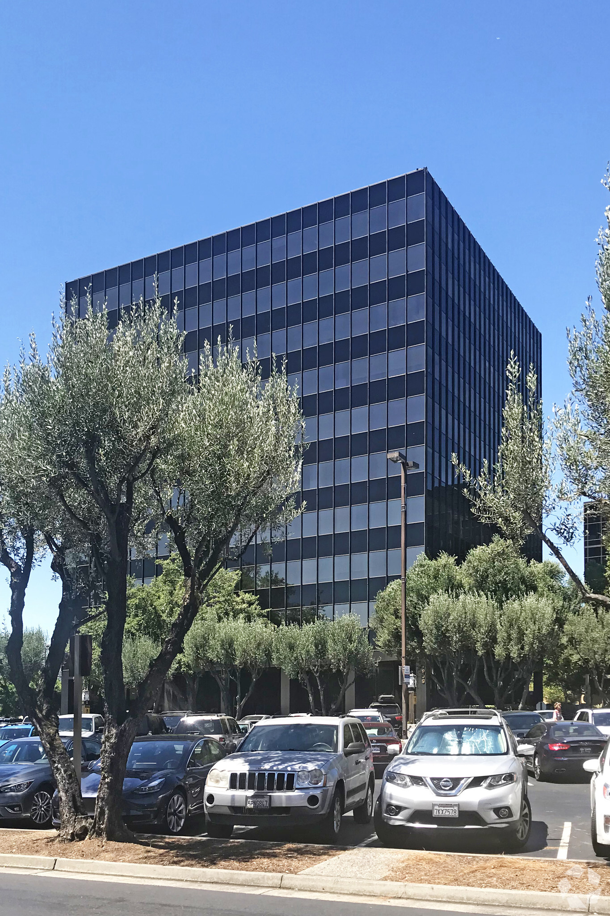
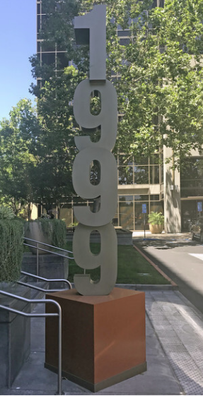
Eclipse Identity Recognition Corporation
Eclipse Identity Recognition Corporation
California
Bogota
Silicon Valley Offices
Eclipse Identity Recognition Corporation © 2025
14
Confidential & Proprietary

Slide 15
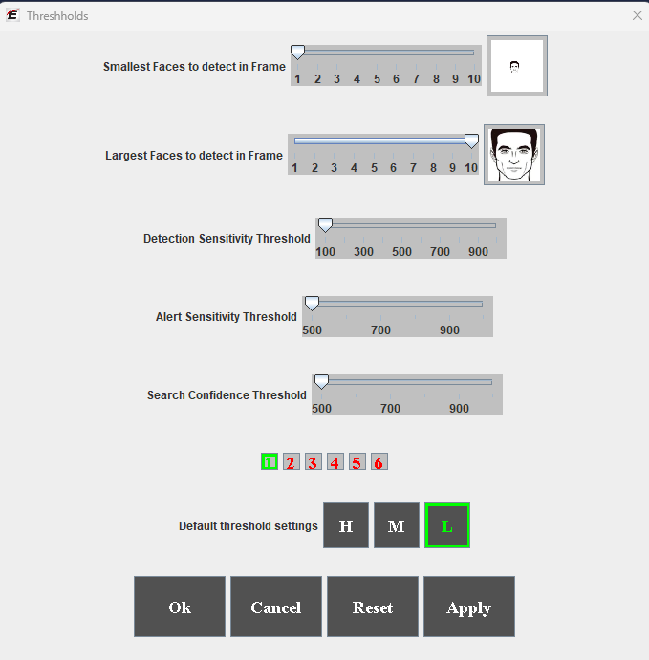
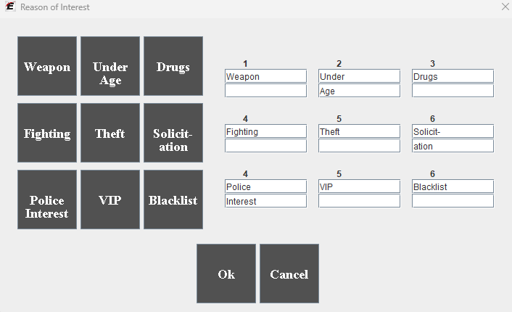
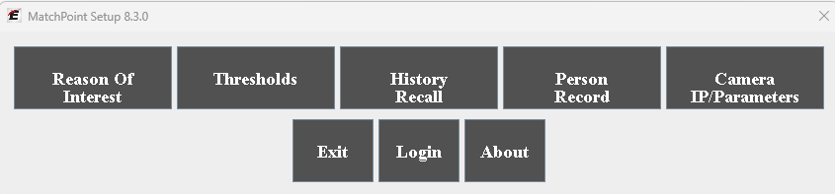
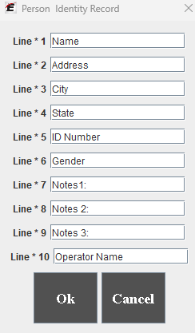
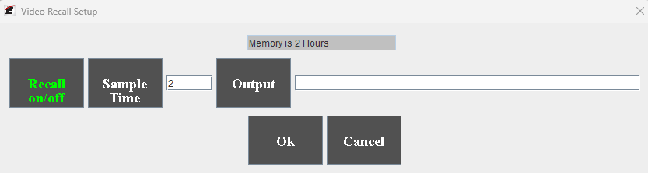
World-class Facial Recognition Technologies
Empowering the User
through optimization
Reasons of Interest (ROI)
System performance thresholds
Recall settings
Database settings
Camera configuration
Eclipse Identity Recognition Corporation © 2025
15
Confidential & Proprietary

Slide 16
World-class Facial Recognition Technologies
Key User-defined Features:
Reasons of Interest (ROI)
What's important to know about the person
Stored in the database
User customizable
System performance thresholds
Recall settings
Database settings
Camera configuration
Eclipse Identity Recognition Corporation © 2025
16
Confidential & Proprietary

Slide 17
World-class Facial Recognition Technologies
Key User-defined Features:
Reasons of Interest (ROI)
System performance thresholds
User define confidence levels
Detection
Match
Search
Dynamic
Different levels in multicamera configurations
Recall settings
Database settings
Camera configuration
Eclipse Identity Recognition Corporation © 2025
17
Confidential & Proprietary

Slide 18
Differentiators
Key Differentiators
Simultaneous multiple face capture from video surveillance
Single-face identity enrollment
Dynamic face database creation
User-defined confidence thresholds
Personal trait-identity recognition technology
Mature and field-proven core technology
Eclipse Identity Recognition Corporation © 2025
18
Confidential & Proprietary

Slide 19
Eclipse Identity Recognition Corporation
Legal Representation
United States
Crone Law Group
9665 Wilshire Blvd., Suite 895,
Beverly Hills, CA 90212
500 Fifth Avenue, Suite 938, New York, NY 10110
NYC Office: 646.861.7891 CA Office: 818.930.5686
www.cronelawgroup.com
Columbia
CONSULTORIA EMPRESARIAL
SUÀREZ Y ASSOCIADOS S.A.S
Carrera 11D No.118A-44, Bogotá, Colombia
Teléfonos: (57) 1 637 3436 / 47 / 58
comunicationes@suarezconsultoria.com
www.suarezconsultoria.com
Eclipse Identity Recognition Corporation
1999 South Bascom Avenue, Suite 700,
Campbell, CA 95008, U.S.A.
(408) 357-0041
www.EclipseIR.com
Stephen Miller, smiller@eclipseir.com
Silicon Valley Offices
Eclipse Identity Recognition Corporation © 2025
19
Confidential & Proprietary

Slide 20
2024 Product Specifications
MatchPoint LITE
Single-camera rapid deployment facial recognition for small venues.
Key Features:
Single Camera
250-person database capacity
Image recalls up to four days
Hardware Specifications:
Processor: | 11th Gen Intel® Core™ i3-1115G4
Ram: | 8 GB
Display: | 1920 x 1280 Resolution
Hard Disk: | 128 GB
Camera: | 640x480, 2.8/10mm lens Target area 3-12 feet from camera
Accessories: | LAN CAT 6 Power over Ethernet (POE)
Notes:
Note 1
(1) Includes software updates
(2) Virtual EclipseIR yearly conference
(3) 96 hour email tech support
(4) Yearly hardware warranty
Note 2
(1) Includes software updates
(2) Virtual EclipseIR yearly conference
(3) 96 hour email tech support(
Image Requirements:
Image Resolution= greater than 60 pixels between the eyes (204 pixels/ft.)
Camera Angle= 10° or less above eye-level 40° or less side view
Camera must accept snapshot string command
Eclipse Identity Recognition Corporation © 2025
20
Confidential & Proprietary

Slide 21
2024 Product Specifications
MatchPoint 6
Multiple- camera for mid-size Corporate and commercial venues
Key Features:
Six simultaneous cameras
10,000-person database capacity
Image Recalls up to 2 weeks
Hardware Specifications:
Processor: | Intel® Core™ i7
Ram: | 16 GB
Display: | 1920 x 1280 Resolution
Hard Disk: | 1 TB, SSD
Camera: | 1280x720, 3.0/12mm lens Target area 3-14 feet from camera
Accessories: | LAN CAT 6 Power over Ethernet (POE)
Notes:
Note 1
(1) Includes software updates
(2) Virtual EclipseIR yearly conference
(3) 96 hour email tech support
(4) Yearly hardware warranty
Note 2
(1) Includes software updates
(2) Virtual EclipseIR yearly conference
(3) 96 hour email tech support(
Image Requirements:
Image Resolution= greater than 60 pixels between the eyes (204 pixels/ft.)
Camera Angle= 10° or less above eye-level 40° or less side view
Camera must accept snapshot string command
Eclipse Identity Recognition Corporation © 2025
21
Confidential & Proprietary

Slide 22
2024 Product Specifications
MatchPoint Commander
Multiple-camera with enhanced communications and alerts
Key Features:
Six simultaneous cameras
100,000-person database capacity
Image recall up to 4 weeks
Advanced notifications and communications
Notes:
Note 1
(1) Includes software updates
(2) Virtual EclipseIR yearly conference
(3) 96 hour email tech support
(4) Yearly hardware warranty
Note 2
(1) Includes software updates
(2) Virtual EclipseIR yearly conference
(3) 96 hour email tech support(
Hardware Specifications:
Processor: | Intel® Core™ i7
Ram: | 16 GB
Display: | 1920 x 1280 Resolution
Hard Disk: | 1 TB, SSD
Camera: | 1280x720, 3.0/12mm lens Target area 3-14 feet from camera
Accessories: | LAN CAT 6 Power over Ethernet (POE)
Image Requirements:
Image Resolution= greater than 60 pixels between the eyes (204 pixels/ft.)
Camera Angle= 10° or less above eye-level 40° or less side view
Camera must accept snapshot string command
Eclipse Identity Recognition Corporation © 2025
22
Confidential & Proprietary

Slide 23
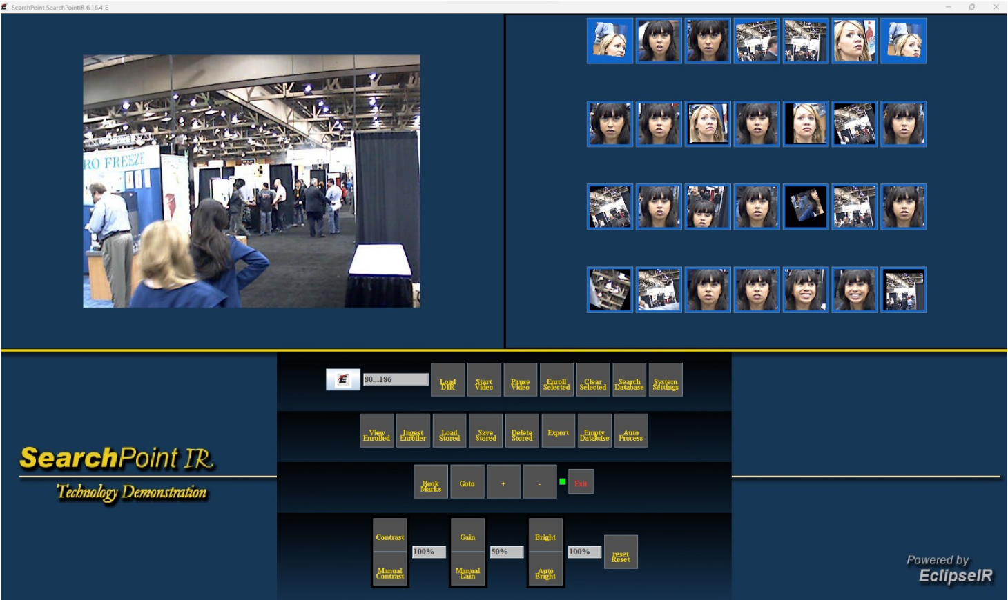
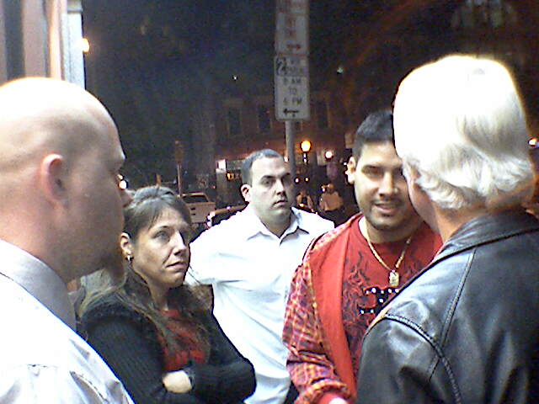
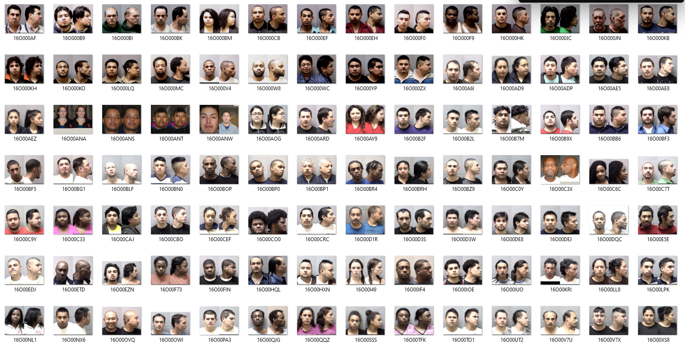
Investigative Analysis of stored video
SearchPoint
Database Management.
Key Features:
Database creation
Dynamic
Automatic
Database import
Database export
Database deletion
Eclipse Identity Recognition Corporation © 2025
23
Confidential & Proprietary

